Slide 1
Module 2 Final Project
Joongsuk Jin
Flatiron School
Data Science Bootcamp Part-TIme

Slide 2
Four Questions for Improving Business
Do discounts have a statistically significant effect on the number of products customers order? If so, at what level(s) of discount?
Does the average revenue per order vary between customers from different regions?
Is the mean freight price significantly different between shipping companies?
Does supply region have a statistically significant effect on unit price?

Slide 3
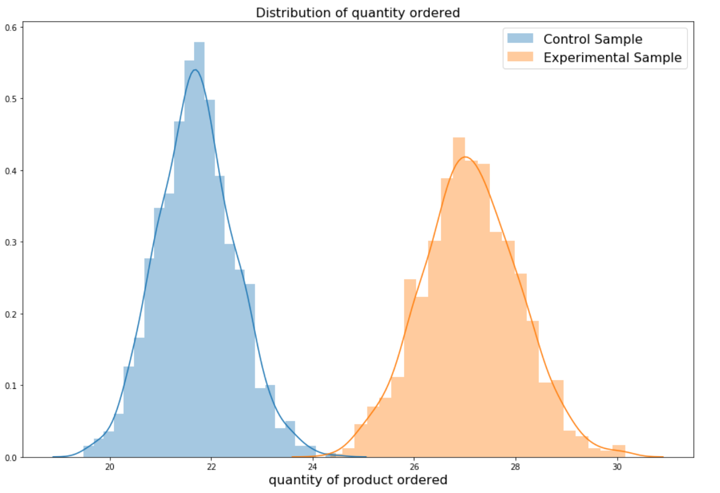
Impact of Discount Rates for Business

Slide 4
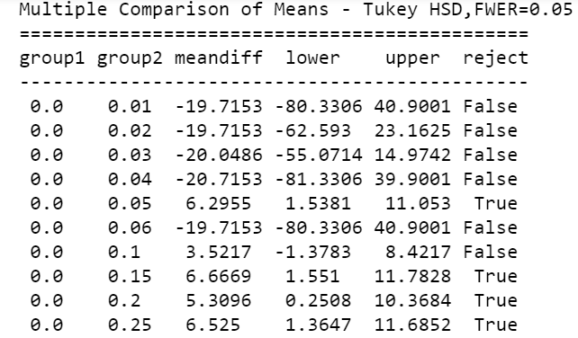
Impact of Discount Rates for Business

Slide 5
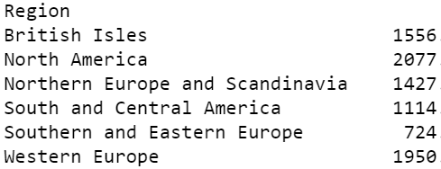
Impact of Customer Region and Revenue
Primary focus for sales!
North America
Western Europe
British Isles

Slide 6
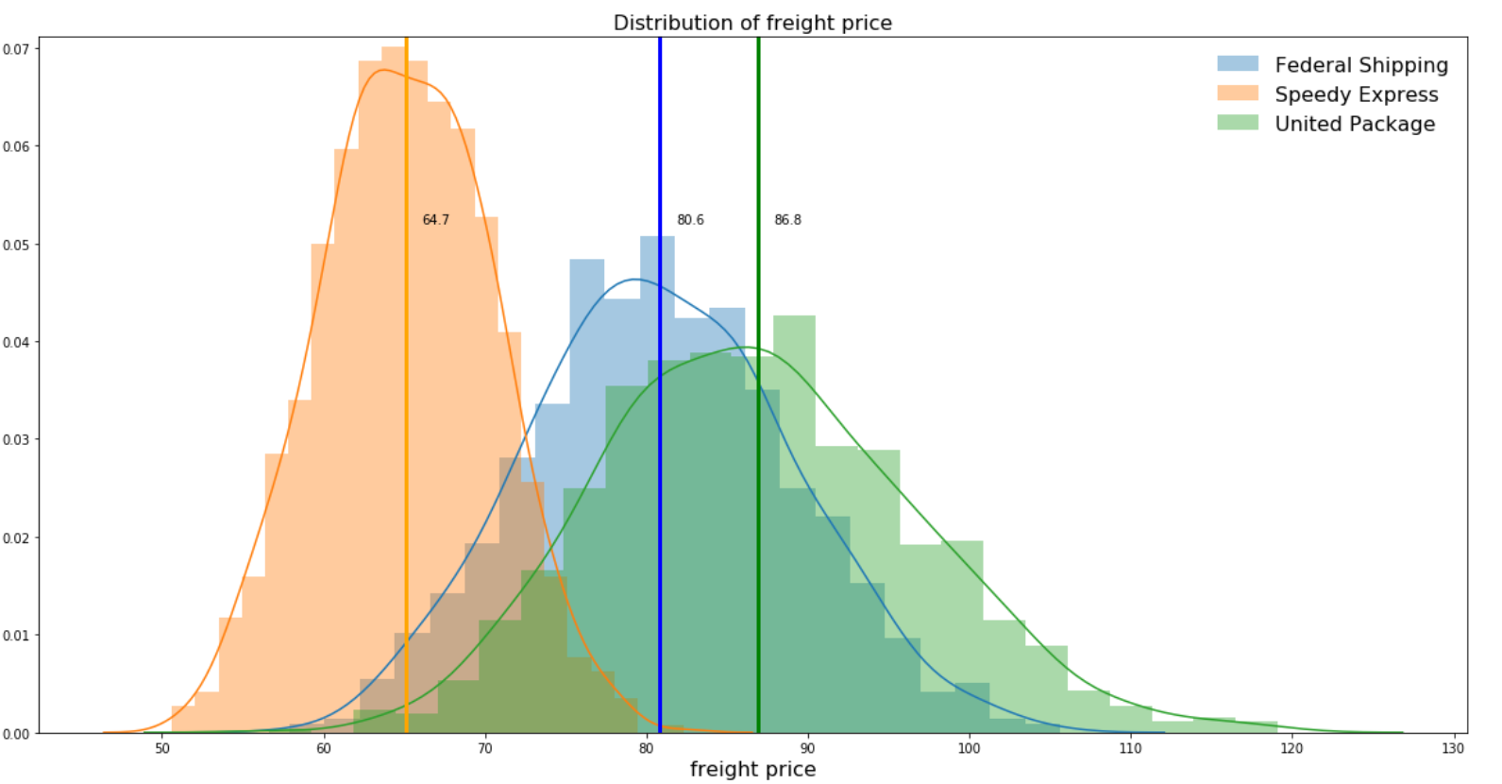
Impact of Shipping Companies and Rates

Slide 7
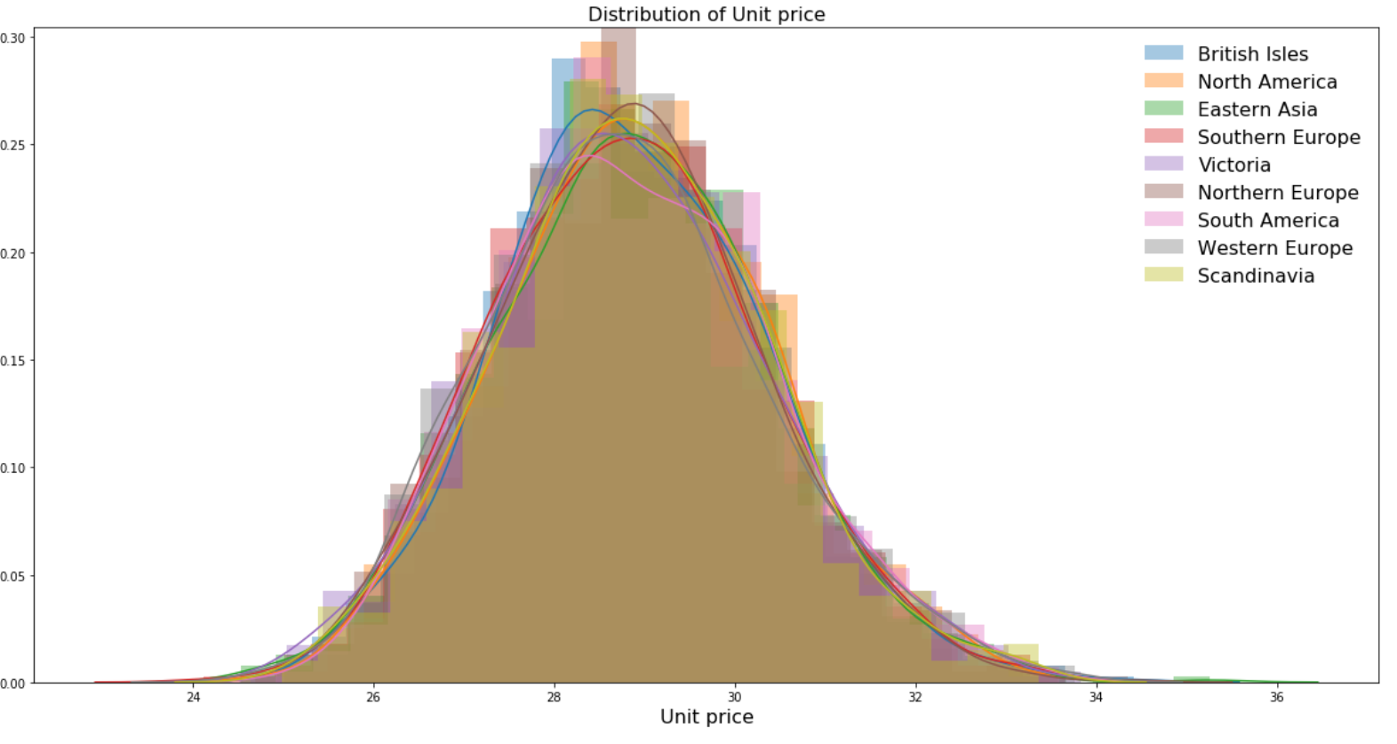
Impact of Supply Region on Unit Price
Unit price of products from different supply regions are ~98 % identical. (based on distribution comparison algorithm) *
2. There is no meaningful difference in supply region on unit price of products.
* The Jensen-Shannon divergence is a principled divergence measure which is always finite for finite random variables. It quantifies how “distinguishable” two or more distributions are from each other.

